Slide 1
Certification of Avionics Embedded Systems
In collaboration with Marinvent Corporation
Chapter 5.3
Supplemental Type Certificate
presented by:
Shawn Coyle
shawn.coyle@marinvent.com

Slide 2

Caution
    This module is designed to show the application of the certification principles contained in the others chapters. As such, it touches upon many aspects of the certification process, but the material is not complete, comprehensive, or necessarily current with the latest regulations and guidance materials. For these reasons, the analysis contained in the following slides should not be used as the basis of a certification program for the system under investigation.

Slide 3
Summary
    5.3 Supplemental Type Certificate
      5.3.1 Definition of Type Certificate
      5.3.2 Purpose of Type Certificate
      5.3.3 Purpose of Design Change Approval
      5.3.4 CAR 507.02
      5.3.5 Kinds of Design Change Approval
      5.3.6 Types of Change
      5.3.7 Part V – Standard 571 Appendix A
      5.3.8 Data Types
      5.3.9 Supplemental Type Certificate (STC)
      5.3.10 Phase IV
      5.3.11 Guidance Material
      5.3.12 Review of Certification Process

Slide 4
5.3.1 Definition of Type Certificate
“a document, (…) issued by the Minister to certify that the type design of an aircraft, aircraft engine or propeller identified in the document meets the applicable standards for that aeronautical product recorded in the type certificate data sheets (…)”.
From CAR 101.01: General Provisions – Interpretation

Slide 5
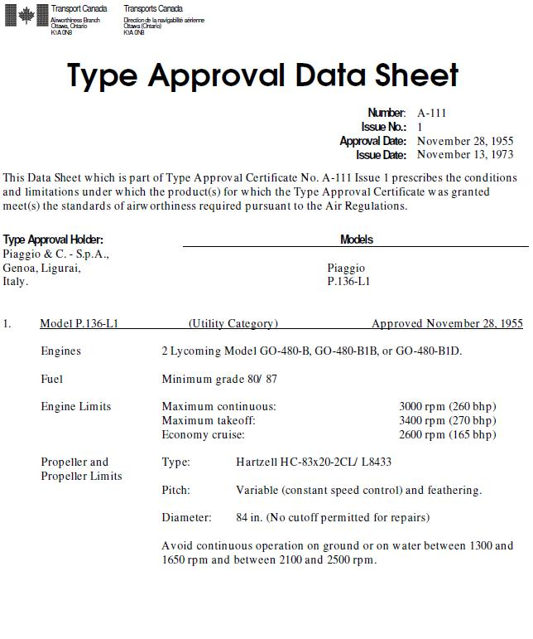
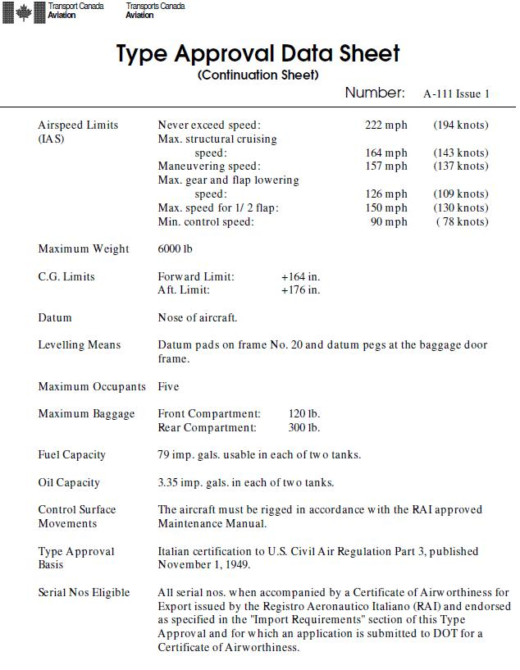
5.3.1 Definition of Type Certificate
Figure 5.3.1 – Type Approval data Sheet for Piaggio P.136-L1

Slide 6
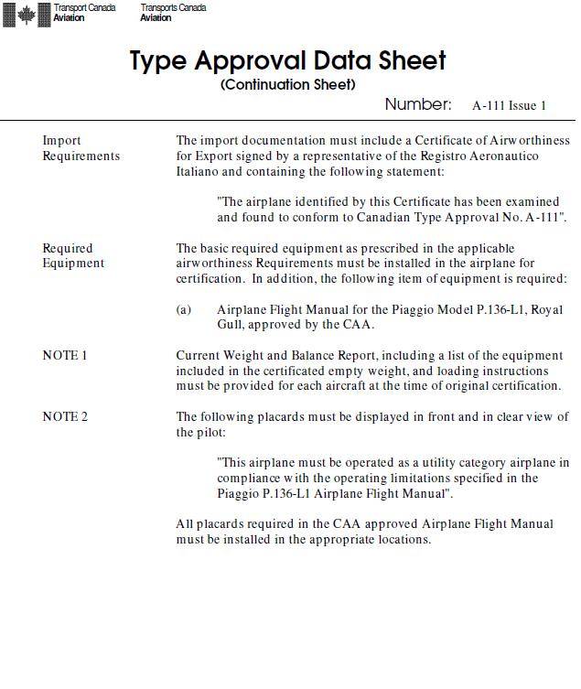
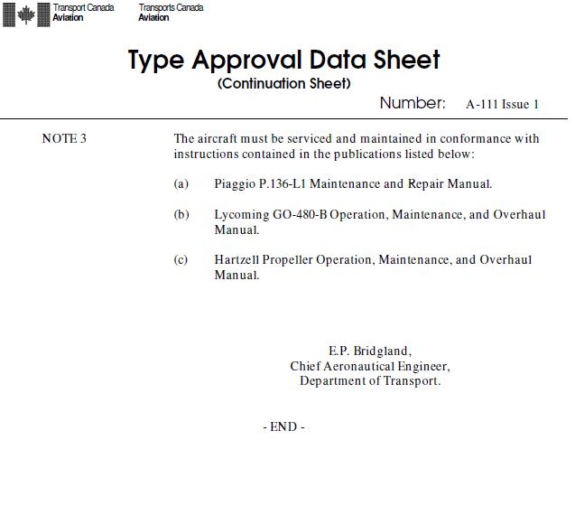
5.3.1 Definition of Type Certificate

Slide 7
5.3.2 Purpose of Type Certificate
Aeronautics Act – 4.9
Authority to create Regulations - CARs
CAR 605.03 – No person shall operate an aircraft in flight unless
a flight authority is in effect in respect of the aircraft
CAR 507.02 – the Minister shall issue a certificate of airworthiness in respect of an aircraft for which an aircraft type design has been certified (…), that conforms to its certified type design; and that is safe for flight.
CAR 521.57 – Type Certificate issued when the type design of the aeronautical product conforms to its certification basis

Slide 8
5.3.3 Purpose of Design Change Approval
Aeronautics Act – 4.9
Authority to create Regulations - CARs
CAR 605.03 – No person shall operate an aircraft in flight unless
a flight authority is in effect in respect of the aircraft
CAR 507.02 – the Minister shall issue a certificate of airworthiness in respect of an aircraft for which an aircraft type design has been certified (…), that conforms to its certified type design; and that is safe for flight.
CAR 521.161 – Certificate issued when the Minister approve a change to the type design of an aeronautical product if the applicant meets the requirements

Slide 9
5.3.4 CAR 507.02
Both fulfill the same purpose: Airworthiness of type certified product (507.02)
507.02 (…) Minister shall issue a certificate of airworthiness in respect of an aircraft
  (a)for which an aircraft type design has been certified by the Minister and the certification is not in respect of a restricted category aircraft;
  (b) that conforms to its certified type design; and
  (c) that is safe for flight.
Some considerations beyond CAR 507.02
  Certificate of Airworthiness (C of A) is needed to fly an aircraft. Without it, the aircraft is illegal for fly. That means: no services, no insurance, no revenue.

Slide 10
5.3.5 Kinds of Design Change Approvals
Repairs
  ”means the rectification of deficiencies in an aeronautical product or the restoration of an aeronautical product to an airworthy condition” ¹
  A Repair Design Approval (RDA) is issued if the repair is approved
Replacement part
  “A part used to replace the original type certified part that does not affect fit, form or function” ²
  If it is the same identical part, it is not a change to a type design
  A Part Design Approval (PDA) is issued if the part is different but match the fit, the form and the function.
¹ From CAR 101.01: General Provisions – Interpretation
² From Transport Canada – Aviation Learning Services PowerPoint

Slide 11
5.3.5 Kinds of Design Change Approvals (cont’d)
Modifications
  “Changes done to enhance the utility of an aircraft. Theses changes are done to the original design for a specific service need or operational role” ¹
  A Supplemental Type Certificate (STC) is issued if the modification is approved
  The only Design Change Approval that we will see in this course
¹ From Transport Canada – Aviation Learning Services PowerPoint

Slide 12
5.3.6 Types of Change
Two types of change
  Major
    “A change to the type design of an aeronautical product that has other than a negligible effect on the weight and centre-of-gravity limits, structural strength, performance, power plant operation, flight characteristics or other qualities affecting its airworthiness or environmental characteristics” ¹
  Minor
    Other than major
¹ From CAR 521.152 (1) – Change to a Type Design

Slide 13
5.3.6 Types of Change (cont’d)
Major modification
  ”Means an alteration to the type design of an aeronautical product in respect of which a type certificate has been issued that has other than a negligible effect on the weight and centre-of-gravity limits, structural strength, performance, power plant operation, flight characteristics or other qualities affecting its airworthiness or environmental characteristics; (modification majeure)“ ¹
¹ From CAR 101.01: General Provisions – Interpretation

Slide 14
5.3.7 Part V – Standard 571 Appendix A Criteria for the Classification of Modifications and Repairs
(a) Operating Limitations
  Does the modification or repair involve a revision in the operating limitations specified in the approved type design?
(b) Structural Strength
  Does the modification or repair alter:
    (1) a principal component of the aircraft structure such as a frame, stringer, rib, spar, skin or rotor blade?
    (2) a life-limited part or a structural element that is subject to a damage tolerance assessment or fail-safe evaluation?
    (3) the strength or structural stiffness of a pressure vessel?
    (4) the mass distribution in a structural element?
    (5) a containment or restraint system intended for occupants or the storage of items of mass (e.g. cargo)?
    (6) the structure of seats, harnesses, or their means of attachment?

Slide 15
5.3.7 Part V – Standard 571 Appendix A Criteria for the Classification of Modifications and Repairs
(c) Powerplant Operation
  Does the modification or repair:
    (1) affect the power output or control qualities of the powerplant, engine, propeller, or their accessories?
    (2) alter the approved operating limitations?
(d) Performance and Flight Characteristics
  Does the modification or repair involve alterations that:
    (1) significantly increase drag or exceed aerodynamic smoothness limits?
    (2) significantly alter thrust or power output?
    (3) affect stability or controllability?
    (4) induce flutter or vibration?
    (5) affect the stall characteristics?

Slide 16
5.3.7 Part V – Standard 571 Appendix A Criteria for the Classification of Modifications and Repairs
(e) Other Qualities Affecting Airworthiness
  Does the modification or repair:
    (1) change the information on, or the location of, a placard required by the type design or an Airworthiness Directive (AD)?
    (2) alter any information contained in the approved section of the aircraft flight manual or equivalent publication?
    (3) affect the flight-crew's visibility or their ability to control the aircraft?
    (4) affect egress from the aircraft?
    (5) reduce the storage capacity of an oxygen system, or alter the oxygen rate of flow?

Slide 17
5.3.7 Part V – Standard 571 Appendix A Criteria for the Classification of Modifications and Repairs
(e) Other Qualities Affecting Airworthiness
  Does the modification or repair:
    (6) affect flight controls or an autopilot?
    (7) alter an electrical generation device, or the electrical distribution system between the generating source and either its primary distribution bus, or any other bus designated as an essential bus?
    (8) reduce the storage capacity of the primary battery?
    (9) affect a communication system required by the approved type design?
    (10) affect instruments, or indicators that are installed as part of a system required by the approved type design?

Slide 18
5.3.7 Part V – Standard 571 Appendix A Criteria for the Classification of Modifications and Repairs
(f) Other Qualities Affecting Environmental Characteristics
  Does the modification or repair increase aircraft noise levels or emissions?

Slide 19
5.3.8 Data Types
Acceptable data, for minor change
Specified data, for major change
Approved data, for major change

Slide 20
5.3.8 Data Types
Acceptable Data
“acceptable data” includes: ¹
  (a) drawings and methods recommended by the manufacturer of the aircraft, component, or appliance;
  (b) Transport Canada advisory documents; and,
  (c) advisory documents issued by foreign airworthiness authorities with whom Canada has entered into airworthiness agreements or memoranda of understanding such as current issues of Advisory Circular 43.13-1 and -2 issued by the FAA, Civil Aviation Information Publications (CAIPs) issued by the Civil Aviation Authority (CAA) of the United Kingdom, or Advisory Circular, Joint (ACJs) issued by the Joint Aviation Authority (JAA) or Acceptable Means of Compliance (AMC) issued by the European Aviation Safety Agency (EASA); and,
  (d) drawings and methods found appropriate by a delegate in conformity with paragraph 4.2(o) and subsection 4.3(1) of the Aeronautics Act.
¹ AWM 571.06 – Repairs and modifications

Slide 21
5.3.8 Data Types
Acceptable Data
“CAR 521.154 – The holder of a design approval document who proposes to make a change to an aeronautical product, other than a change to the type design referred to in subsection 521.152(1) shall establish procedures to ensure that the changed aeronautical product continues to conform to its certification basis and make the change after the Minister accepts the procedures.” ¹
¹ CAR 521.154 – Change Other than a Change to the Type Design

Slide 22
5.3.8 Data Types
Acceptable Data
“Acceptable data may be used for minor modifications (…) without the issuance of a design approval document of the Minister.” ¹
Design Approval holder have to confirm, with this data, that the proposed change will not have any modification to the product certification basis
Design Approval holder establish procedures, Minister accepts the procedures, then change can be made
¹ From Transport Canada – Aviation Learning Services PowerPoint

Slide 23
5.3.8 Data Types
Specified Data
“specified data is information contained in authoritative documents which, although not approved by the Minister, has been specified by the Minister as appropriate for the purpose of major modifications and major repairs, in conformity with section 571.06 of the CARs. (…)” ¹
¹ AWM 571.06 – Repairs and modifications

Slide 24
5.3.8 Data Types
Specified Data
Specified data includes:
  “(a) drawings or methods described or referenced in Airworthiness Directives;
  (b) data issued by the manufacturer or type certificate holder (…), such as modification orders, service bulletins, or engineering orders, which include a statement of approval by the applicable regulatory authority or a delegated representative of such an authority. l;
  (c) manufacturer’s Structural Repair Manuals;
  (d) FAA Advisory Circulars AC (…) AC 43.13-2” ¹
¹ AWM 571.06 – Repairs and modifications

Slide 25
5.3.8 Data Types
Specified Data – AC 43.13-2
“(d) FAA Advisory Circulars AC (…)AC 43.13-2, subject to the following conditions:
  (i) the aircraft is a small aircraft, and the alteration does not affect dynamic components, rotor blades, structure that is subject to pressurization loads, or the primary structure of a rotorcraft;
  (ii) the alteration does not affect an existing limitation (including the information contained on mandatory placards) or change any data contained in the approved sections of the Aircraft Flight Manual, or equivalent;
  (iii) the data are appropriate to the product being altered, and are directly applicable to the alteration being made; and,
  (iv) the data are not contrary to the aircraft manufacturer’s data.” ¹
¹ AWM 571.06 – Repairs and modifications

Slide 26
5.3.8 Data Types
Specified Data
It is the responsibility of an Approved Maintenance Organization (AMO) or an Aircraft Maintenance Engineer to be sure to have enough data for a conformity inspection
Data must cover all aspects of the design change

Slide 27
5.3.8 Data Types
Approved Data
All data included in authoritative documents
  Type Certificate (TC)
  Supplemental Type Certificate (STC)
  Repair Design Approval (RDA)
  Part Design Approval (PDA)
  Canadian Technical Standard Order (CAN-TSO)
  Any other approved drawings
  “(a) type certificates, supplemental type certificates, part design approvals, Canadian technical standard order (CAN-TSO) design approvals or repair design approvals, including equivalent foreign documents which have undergone the type design examination process set-out in Subpart 521 of the CARs or are otherwise accepted in Canada; and (b) other drawings and methods approved by the Minister or a delegate in conformity with paragraph 4.2(o) and subsection 4.3(1) of the Aeronautics Act.” ¹
¹ AWM 571.06 – Repairs and modifications

Slide 28
5.3.9 Supplemental Type Certificate
“Supplemental Type Certificate means a document (…)issued by the Minister to record the approval of a change to the Type Design of:
  (a) an aeronautical product identified in the document by a single serial number,
  (b) several aeronautical products of the same type or model, approved under a single Type Certificate and identified in the document by their serial numbers, or
  (c) several aeronautical products of differing types or models, approved under separate Type Certificates and identified in the document

Slide 29
5.3.9 Supplemental Type Certificate
Serial STC
Under the subparagraph (a) of definition:
  “limited to a single aircraft or aeronautical product identified by a serial number and an according registration mark
  Can be issued by TCCA or a delegate
  Used for modifications only, not for repairs or part replacements
  Type Design is defined/documented to a level of details that assures repeatability of the manufacture, installation, maintenance and operation of the modified product
  Usually issued to someone other than the Original Equipment Manufacturer (OEM) upon demonstration that the change to a type design conforms with the applicable certification basis
  $470$ fee” ¹
¹ From Transport Canada – Aviation Learning Services PowerPoint

Slide 30
5.3.9 Supplemental Type Certificate
Under the subparagraph (b) of definition:
  “Can be issued by TCCA or a delegate
  Used for modifications only, not for repairs or part replacements
  Type Design is defined/documented to a level of details that assures repeatability of the manufacture, installation, maintenance and operation of the modified product
  Usually issued to someone other than the Original Equipment Manufacturer (OEM) upon demonstration that the change to a type design conforms with the applicable certification basis
  $600$ fee” ¹
¹ From Transport Canada – Aviation Learning Services PowerPoint

Slide 31
5.3.9 Supplemental Type Certificate
Under the subparagraph (c) of definition:
  “Only TCCA can issue STC
  Used for modifications only, not for repairs or part replacements
  Usually issued to someone other than the Original Equipment Manufacturer (OEM) upon demonstration that the change to a Type Design conforms with the applicable certification basis
  $1,900$ fee” ¹
¹ From Transport Canada – Aviation Learning Services PowerPoint

Slide 32
5.3.9 Supplemental Type Certificate
There might be some difference in the documentation of the Type Design
  But no difference for the demonstration of conformity with the certification basis

Slide 33
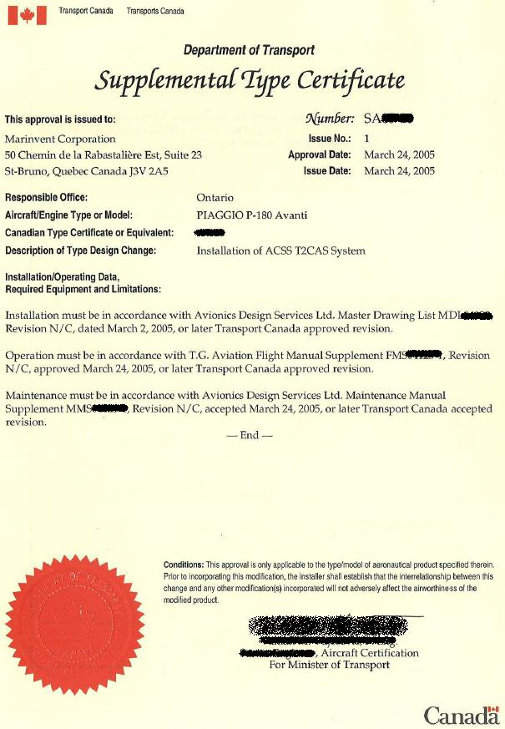
5.3.9 Supplemental Type Certificate
Figure 5.3.1 – STC

Slide 34
5.3.10 Phase IV
Approval of a Design Change
Statement of Conformity (SoC)
  Statement from Delegate Authority
  The SoC itself is not the approval, it is the document which states the conformity
  Shall state:
    All data used to demonstrate conformity
    Reference from the Certification Plan

Slide 35
5.3.10 Phase IV
Applicant’s Declaration
“On behalf of (Applicant) I hereby declare that (Applicant) has demonstrated to the Change in Type Design conforms to the certification basis established by the Minister under section 521.157 of the CARs” ¹
¹ From Transport Canada – Aviation Learning Services PowerPoint

Slide 36
5.3.10 Phase IV
Responsibilities of a Holder
“An Applicant for the approval of a change to the Type Design of an aeronautical product shall
  (e) submit a signed undertaking to carry out the responsibilities specified in Division VIII”
    521.352 Technical Capability
    521.353 Service Difficulty Reporting
    521.354 Establishing an SDR System
    521.368 Provision of ICAs
    521.369 Supplemental Integrity Instructions
¹ From CAR 521.160: Conformity with Certification Basis

Slide 37
5.3.11 Guidance Material
Staff Instructions (SI) 513-007
  Approval of Domestic Modification and Repair Design
    Domestic STC
    Serial number STC
    FAA STC based on domestic STC
Staff Instructions 513-003
  Acceptance and Approval of Foreign Design Changes
    Domestic STC based on Foreign STC

Slide 38
5.3.12 Review of Certification Process
Emphasis on communication between TCCA and Applicant
Agreement on certification basis, compliance methods, documentation requirement needed
Certification Plans
Applicant makes tests and sends results and documents to the Authority
Authority reviews
Submission of Applicant’s Declaration and the Holder’s signed Undertaking
Supplemental Type Certificate issued

Slide 39
References
CAR 101.01: General Provisions – Interpretation http://www.tc.gc.ca/eng/civilaviation/regserv/cars/part1-subpart1-1104.htm
AWM 571.06 – Repairs and modifications http://www.tc.gc.ca/eng/civilaviation/regserv/cars/part5-standards-571s-1827.htm#571s_06
CAR 521.160: http://www.tc.gc.ca/eng/civilaviation/regserv/cars/part5-521-232.htm#521_160
CAR 521.154: http://www.tc.gc.ca/eng/civilaviation/regserv/cars/part5-521-232.htm#521_154
From CAR 521.152: http://www.tc.gc.ca/eng/civilaviation/regserv/cars/part5-521-232.htm#521_152
Transport Canada – Aviation Learning Service Branch

Slide 40
Image References
Figure 5.3.1: http://wwwapps.tc.gc.ca/saf-sec-sur/2/nico-celn/c_s.aspx?lang=eng
Figure 5.3.2: Courtesy of Marinvent Corporation

